Slide 1
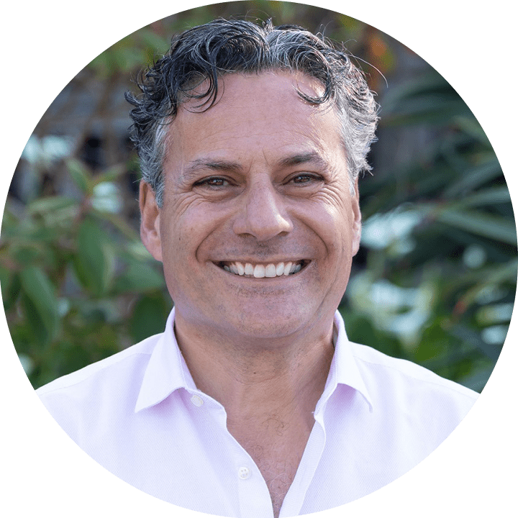
Strategic Enablement Plan - Template
Use this template to organize your enablement plan and align with your stakeholders
ELAY COHEN
CEO & Co-Founder

Slide 2
Enablement Program Plan: Executive Summary
Program Vision
Write a 2 to 3 sentence program vision.
Time-Frame
Roles | Leading Indicators | Lagging Indicators
 | Meetings scheduled Pipeline created | Win-rates Attainment
Expected Outcomes | Resources Required
Be specific Do the math Project impacts | What resources are required or requested to ensure success of the program?

Slide 3
Explain the Why
CURRENT SITUATION
ISSUES
IMPACTS
What are the issues?
Internal + External
What are the impacts of the issues?
Be specific
Quantify impact
List out the current situation
Be crisp

Slide 4
Align With Your Sales Leadership
Performance
Role | Today | Growth | Leading Performance Indicators | Efficiency Gaps
AEs | # | #
Scs | # | #
SDRs | # | #
CSMs | # | #
Managers | # | #

Slide 5
High Impact, Engaging Learning
Learning Modes
TRAINING GOALS
CONTENT CREATION
WRITING EXERCISES
(QUESTIONS & ANSWERS)
What are the training goals?
What are the expected outcomes?
What content will be created to train our teams?
What system will be used?
ROLE-PLAYING
(VIDEO OR LIVE)
STAND & DELIVER
(SHORT & LONG PITCH)
LEARN BY DOING
REINFORCEMENT
TESTS
(MULTIPLE/SINGLE CHOICE)
How will the learning be executed and delivered?
What assessments will measured?
How will coaching be reinforced by managers?
How will coaching activities be measured?
GROUP DISCUSSIONS
(INFORMAL AND FORMAL)
APPLICATION
(REAL DEAL EXERCISES)
SUCCESS STORIES
(WIN & LOSS REVIEWS)

Slide 6
Buyer’s Journey Content & Tools Strategy
EDUCATE
EXPLORE
EVALUATE
EXPERIENCE
EXPAND
Website
Webinars
Whitepapers
Blogs
Emails
Pitch
Meetings
Demos
Case Studies
References
FAQs
Trials
Objectios
Mutual Plans
Business Cases
Proposals
Buyer Sites
e-Signature
Success Plans
Admin Training
Use Case Stories
Community
Customer Events
Value Summaries

Slide 7
Communication Plan
Communication Goals: One sentence summary (awareness, education, motivational)
Audience | WIFM Messaging | Channel | Frequency | Owner
Role #1
Role #2

Slide 8
Project Plan
ACTION | Owner | Due Date

Slide 9
Resources Required
Resources Required
Red Flags
Resource | Cost
Systems
People
Content
Third Party Services
Resource | How to Overcome
Exec Alignment
Personnel
Content
Time
Too much going On

Slide 10
Supporting Slides

Slide 11
Enablement Process Map
LESS MATURE
GO-TO-MARKET
LEARNING
COMMUNICATIONS
CUSTOMER ENGAGEMENT
ACHIEVEMENTS
Metrics & KPIs
Pitch & Product
Team Huddles
Prospecting
Attainment
Motions
Skills Training
Content Library
Value Selling
Win Stories
Activities
Assessments
Playbooks
Call Execution
Compensation
Sales Planning
Social Learning
Broadcasts
References
Incentives
Budgets & ROI
Coaching
Calendar
Proposals
Kickoffs
Plans by Role
Onboarding
Crowdsourcing
Negotiations
Correlations
MORE MATURE

Slide 12
Sales Performance Benchmark Stats
20% of sellers create 80% of revenue (Xactly)
43% of sellers hit quota (Salesforce)
Average sales tenure is 18 months (Xactly)
87% of sales training is forgotten by sales reps within a month. Many call this the forgetting curve. (Gartner)
35% of seller time is spent engaged with buyers. Processes are complex. Content is hard to find. (Forrester)
80% of decision makers prefer remote human interactions or digital self service. Sellers aren’t equipped. (McKinsey)
Typical seller only spends 23% of time on customer-facing activities (Forrester)
Notes:
Here’s what we’re seeing in the industry.
Most companies have 20% of their top salespeople contributing 80% of revenue and at best 50% of sellers are hitting quota. (CSO Insights)
That means that 1/2 of salespeople are struggling.
Average tenure is 18 months. (Xactly Corporation).
Most of our customers come to us with very similar performance.
Why is this happening? Most underperforming and struggling with sales efficiency across these dimensions:
Cycle Time is too long
Ramp time is too long
Selling time is too short
Win rates are too low
How does this compare to what’s happening in your business?
(Pause, listen and be curious..)
Thanks for sharing. We’re seeing more trends that are making sales harder in 2022 especially in our hybrid remote working world.
Resources
43% of reps hitting quota comes from Forrester, Salesforce and Xactly.
https://www.forrester.com/blogs/sales-success-not-about-hitting-quota/
Xactly https://www.xactlycorp.com/blog/sales-turnover-statistics (The loss revenue of rep attrition is in the billions)
Gartner research finds that B2B sales reps forget 70% of the information they learn within a week of training, and 87% will forget it within a month
https://www.gartner.com/smarterwithgartner/the-evolution-of-sales-training-and-coaching-technology

Slide 13
Revenue Enablement Maturity Model
Phase 1
Messaging Alignment
Phase 2
Sales Process & Skills Activation
Phase 3
Product Proficiency
Phase 4
Onboarding By Role
Align all customer-facing teams on messaging to boost conversation competence and confidence across the buyer’s journey
Create repeatable and predictable go-to-market sales motion by developing the sales process and sales skills to improve efficiency all revenue teams
Activate product proficiency with a proven process to create engaging training and assessments for products, solutions, use cases, industry and sales plays
Create personalized onboarding experiences by role including core content pillars, activity based learning and assessments
PRIORITIES
Pipeline
Conversations
Win-Rates
Sales Cycle Time
Pipeline
NB/Cross Sell/Upsell
Ramp Time
Quota Attainment
OUTCOMES
Stakeholder Alignment
Enablement Plan
Accreditation Program
Content Governance
PROCESS

